Slide 1
Mecklenburg
Skool Picker
A Project No.3 By Group 6
A joint effort by Pragya, Sajita, Amrita, Nobon, Jason_K, J_Tan

Slide 2
Proposal
Main intention is to create a simple map that allows user to pick a public school in Mecklenburg, NC, by utilising the housing prices heatmap as a choice criterion.
Datasets used:
School names and addresses: CMS List of Schools: (www.wearecms.com/apps/pages/allschools)
School ratings: www.Schooldigger.com
Housing median prices: www.mecknc.gov

Slide 3
Data Scraping
Our group had this main idea to streamline school picking process. To enable this, we will need various data.
-School data (name, grade, address, images, rating, lat long)
-Housing prices(boundaries, median prices, quantity of units, type of houses)
*Our group used jupyter notebook to do most of the scraping, data cleanup (merging, dropping columns, filling empty data)
*Data will then be stored in a database through postgresql

Slide 4
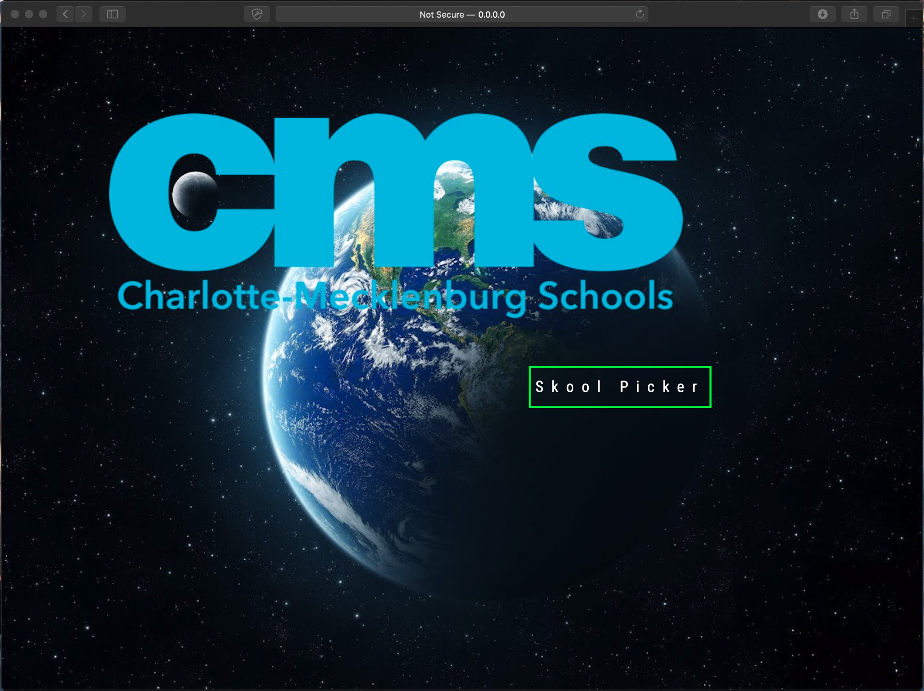
Landing page has only one button
Click on the button to start the school picking process
Pages are ‘route’ed using flask app
Each page having its own .html page

Slide 5
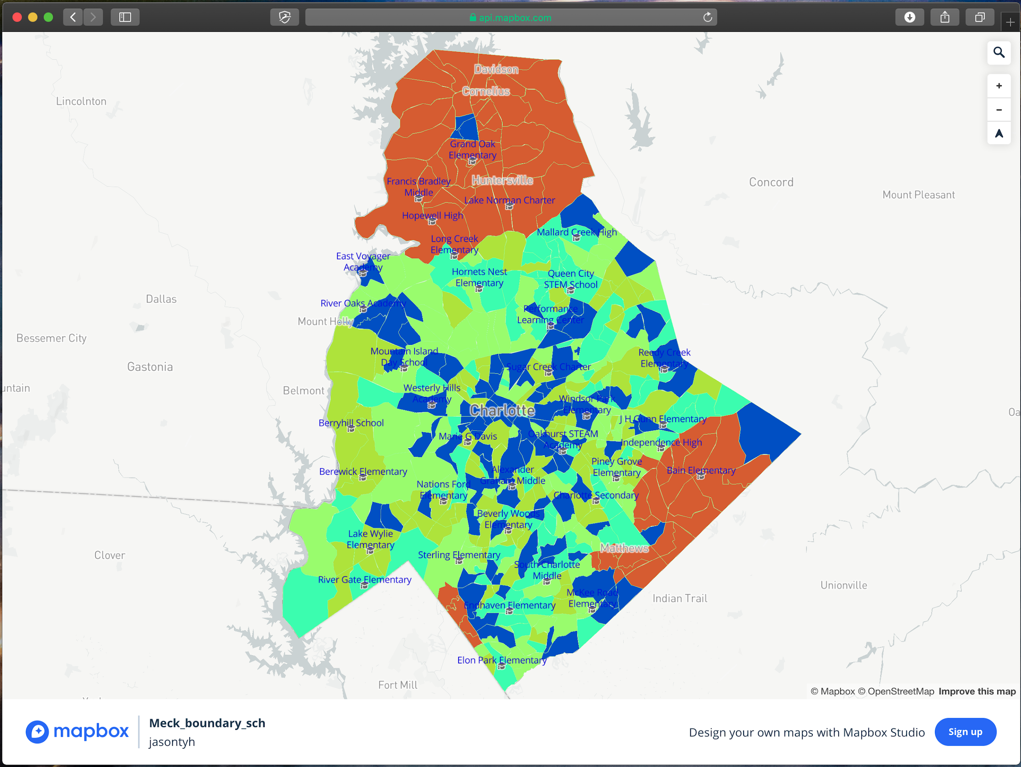
Using mapbox studio to create map of school locations and boundaries
Boundaries includes Mecklenburg county boundary
Data uploaded to mapbox using geojson

Slide 6
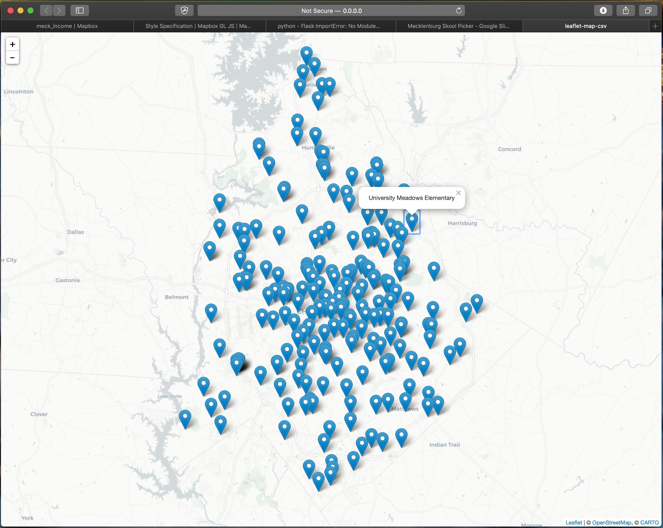
Housing prices should be able to be filtered by prices
Visually clustered, and expands when zoomed in

Slide 7
Create choropleth heatmap of median house prices for each boundary
Prices legend showing the range of median housing prices

Slide 8
Housing prices should be able to be filtered by prices
Visually clustered, and expands when zoomed in

Slide 9
Thank You

